Slide 1
Library Ebook
Working Group

Slide 2
Advisory Board
SimplyE for Consortia
Workstream
Projects
Distributors
SimplyE
LEAP
Marketplace
Related Orgs
Operational Readiness
Open eBooks
Outreach &
Advocacy
Enki
Publishers
Tech Functionality
Vendors
Content
DCWG
Governance
Amigos
ASCLA
Ebook Super Friends
ReadersFirst
Bookstores
Notes:
Layout of library ebook ecosystem

Slide 3
Ebook Working Group
SimplyE for Consortia
Distributors
SimplyE
LEAP
Marketplace
Operational Readiness
Open eBooks
Publishers
Outreach &
Advocacy
Vendors
Content
Tech Functionality
DCWG
Governance
ASCLA
Ebook Super Friends
ReadersFirst
Bookstores

Slide 4
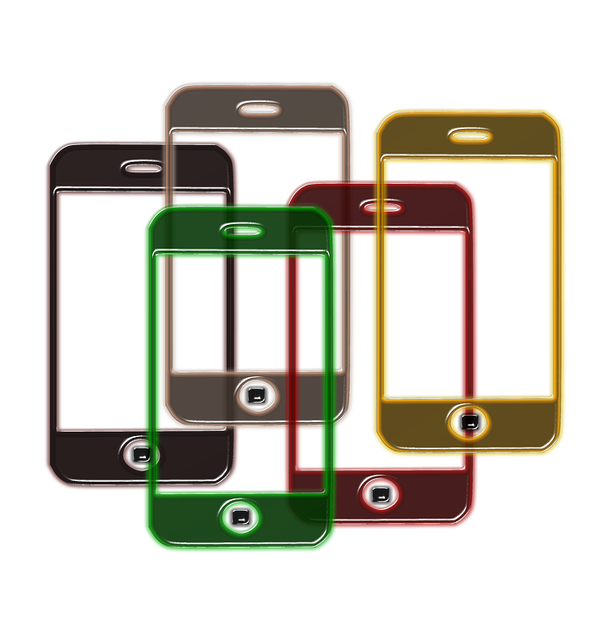
Library Ebook “Super Friends” Advisory Board
A small group of leaders tasked with:
driving momentum toward a national digital strategy
offering input where needed
facilitating connections within community

Slide 5
Workstreams
Tech
Functionality
Content
-indie & self pub
-licensing models
-alternative formats
-public domain
-test products
-prioritize features
Governance
- offer recommendations on library-owned products and organization
-advise on digital content projects
Outreach &
Advocacy
Operational Readiness
- promote initiatives to larger community
-recruit members
-identify opportunities
-business operation
Notes:
Workstreams provide the support for our projects. Allow for streamlining efforts across projects. They are comprised of all librarians willing to volunteer. In many cases, the workstreams already exist!

Slide 6
Projects
SimplyE
SimplyE for Consortia
Amigos
LEAP
Marketplace
Enki
Open eBooks
Notes:
Workstreams can support these projects. What else?

Slide 7
List of super friend inputs
Groups
Readersfirst
ALA DCWG
ASCLA
GWLA
Charlotte Initiative
ICOLC
Thematic workstreams
Interoperablity
Communication and advicacy
Projects
LEAP
SimplyE
SimplyE for K12
SimplyE for Reseach

Slide 8
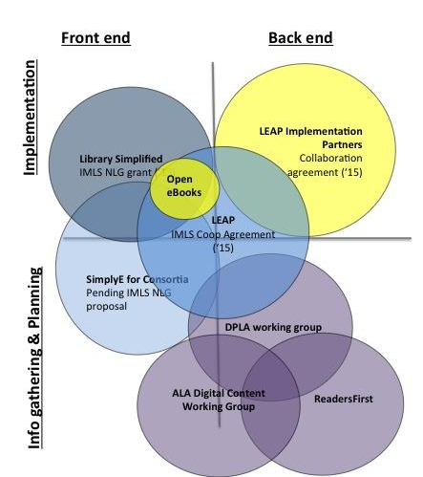
Partners/Related work
Other orgs:
-ASCLA
-GWLA
-Charlotte Initiative
-ICOLC
Notes:
This graphic represents projects NYPL is working on; what other large-scale, collaborative, and/or nationally scoped ebook groups and projects are there?

Slide 9
Communication strategies
Phone call
Listserv
Face to face meetings
Google+ community
Wiki space
Notes:
Need to remain accessible and transparent
Regular phone calls for each workstream?
Listserv for sharing information with larger community
Face 2 face meeting each quarter
Community conversations on Google+
Final products live on Wiki space

