Slide 1
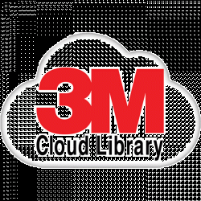
Libraries don’t own their relationships with customers
LIBRARIES
$$$
Notes:
Libraries pay vendors who cut them out of relationships with library customers. Library customers have accounts with vendors. Are vendors collecting customer information? What are they doing with it?
Different platforms cause frustration, confusion for customers. Same content in multiple places– have to check all individually, learn different platforms

Slide 2
Libraries don’t have relationships with publishers
LIBRARIES
$$$
PUBLISHERS
Notes:
Vendors act as the “middle man.” For-profit aggregators means increased costs for libraries who can’t negotiate with or buy content from publishers directly.

Slide 3
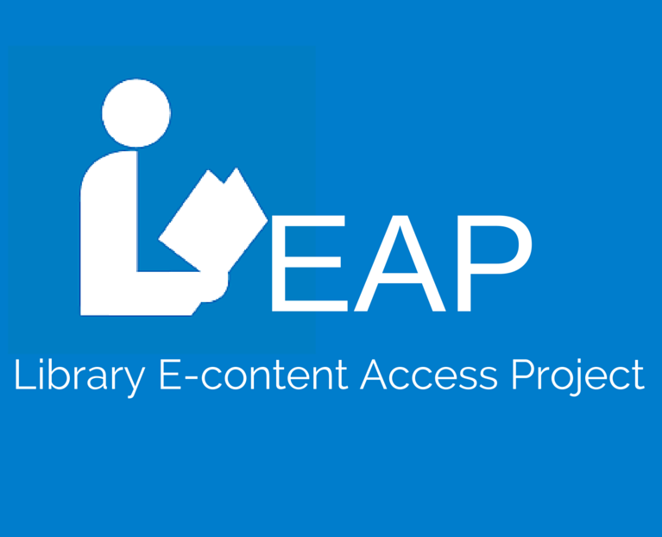
An Idea for a Solution
Notes:
A joint funded project from NYPL and IMLS has led to the development of an app for discovery of library eContent in one place.

Slide 4
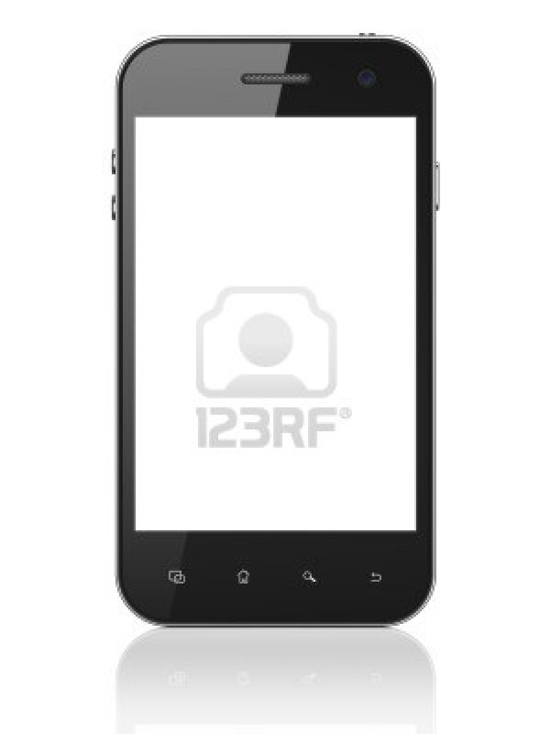
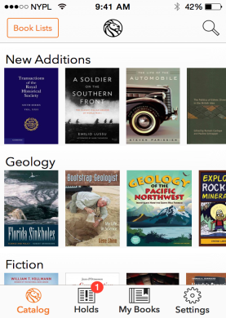
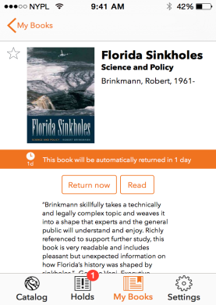
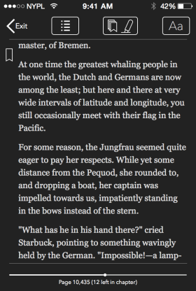
Library Simplified App
In 3 Clicks Or Less…
Discover
Borrow
Read
Notes:
Addresses libraries not owning relationships with customers. Instead of customers having accounts with multiple vendors to access e-content, they use their library card and access all e-content in one, library controlled environment. Unifies collections, see all available titles without having to go to multiple places. Addresses accessibility for all.
3 Steps: sign in to catalog, search for title, download eBook

Slide 5
Library E-Content Access Project (LEAP)
Notes:
LEAP grew out of Library Simplified. It’s a two-year project responding to IMLS’s “National Digital Platform” priority. “In close collaboration with the Digital Public Library of America (DPLA), NYPL and its 19 nationwide partner libraries and library consortia will expand and provide outreach for the existing Library Simplified application, engage in in-depth planning for its sustainable maintenance and ongoing development, facilitate a national conversation about the challenges and potential of library e-books, build consensus around a possible solution addressing these needs and opportunities, and, as appropriate, begin to prototype that solution.” (from Librarysimplified.org) The Library Simplified App is the first deliverable of the LEAP initiative. The app is called “SimplyE” for copyright considerations.

Slide 6
Library E-Content Marketplace
Direct contact
Direct distribution
LIBRARIES
PUBLISHERS
Notes:
Another deliverable: creation of plan for a library-run marketplace that allows for direct distribution from publishers to libraries via one, library-run marketplace.
This platform could:
Be built and live within a few years
Start with eBooks but eventually expand
Follow and advance ReadersFirst principles
Quickly become self-sustaining
Offers a WIN-WIN for publishers and libraries (improved business relationships could impact quality and cost of licensing, and removing vendors from the conversation could result in libraries having more money to spend on content)
Be decentralized
Use a small portion of revenue to support other critical leadership work
Addresses libraries not having relationships with publishers. Library-run marketplace would be non-profit, would work directly with publishers. Cut out the middle men. Work with publishers to develop beneficial models that work with library budgets. Eliminates buying same content from multiple vendors.

Slide 7
Other Aspects
of LEAP
Notes:
The project has two other deliverables. First, the creation of an improved back-end catalog of public domain works identified from sources including Project Gutenberg and DPLA hubs. Metadata will be standardized, covers will be added if necessary, and libraries with the Library Simplified app will have access to the content.
The Open eBooks initiative uses the Library Simplified app to connect in-need children with books. In summer 2015, librarians and media specialists curated books donated by publishers and the initiative was launched in late February 2016. The public domain catalog created as part of LEAP will add to the variety of titles available through Open eBooks.

Slide 8
SimplyE for Consortia
LIBRARY
LIBRARY
LIBRARY
Notes:
SimplyE for Consortia slide for use if desired.
Library Simplified app on a consortia level. Jointly funded by Minitex and IMLS. Along with RAILS and Massachusetts State Library, this team, in collaboration with the NYPL's Library Simplified product development team will research, design develop and deploy the functionality needed to federate and combine eBooks from public library collections with statewide, consortial, and/or national eBook collections, and deploy consortial versions of SimplyE in Minnesota, Illinois, and Massachusetts by 2018. The project will also develop specifications for enhancing SimplyE to better support academic and school library users by adding features such as enabling citations, group annotations, and embedded assessments.

Slide 9
Get Involved
readersfirst.org
dp.la/info/get-involved/dpla-ebooks
librarysimplified.org
Notes:
On Library Simplified:
Advocate for ReadersFirst and it’s principles
Spread the word, plug into DPLA eBook working group
Set up and support an instance of Library Simplified f
Join Readium and support open source library solutions
Co-sponsor enhancement to LS including around accessibility
On LEAP (building the market place):
Stay plugged into planning
Join emerging joint venture, contribute significant resources and become a co-founder
How to learn more: librarysimplified.org, contact info
How to get involved: contact info
Add a final slide with presenter info if necessary

