Slide 1
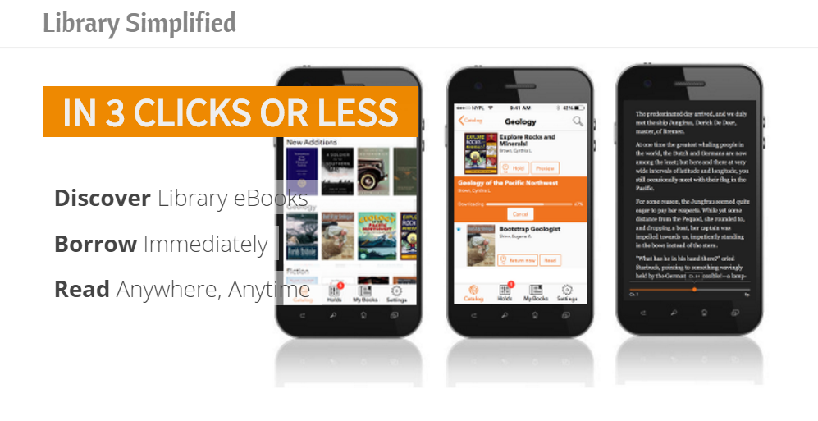
SimplyE … ebook dreams and struggles
Valerie Horton, Minitex

Slide 2
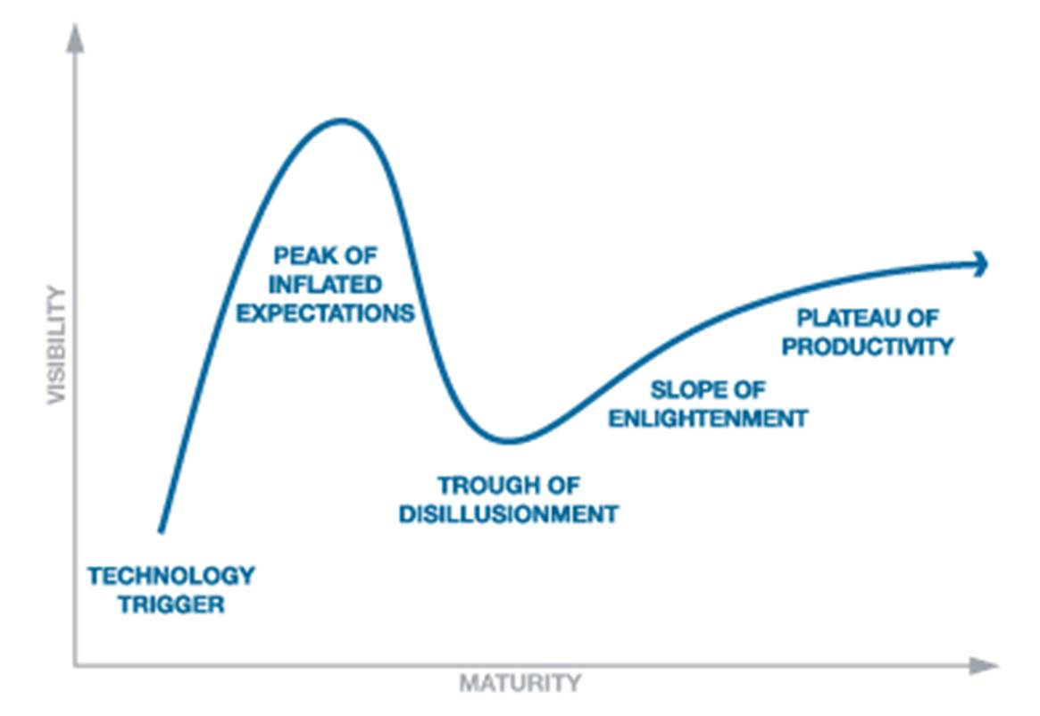
Hype Cycle
Notes:
Bleeding edge, we’re not at early adopter

Slide 3
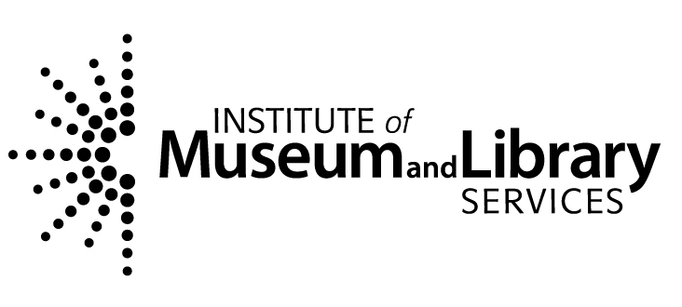
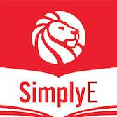
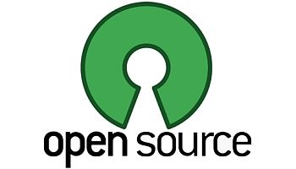
What is SimplyE?
Grant: Library Simplified
Brooklyn Public Library
Boston Public Library
Sacramento Public Library
Santa Clara County Library
Alameda Public Library
Kent District Library
Cincinnati County Public Library
Cuyahoga County Public Library
Chattanooga Public Library
Notes:
What year?

Slide 4
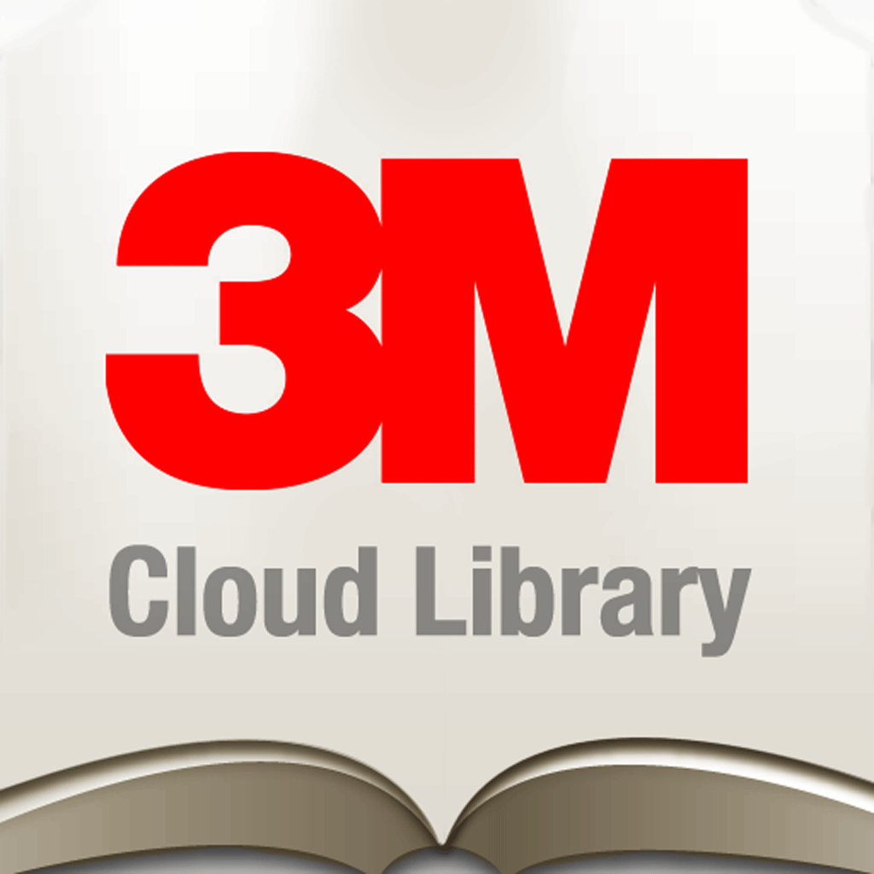
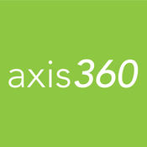
Value Proposition * 3 clicks and read * A good reader * Merged ebooks collections
Notes:
Other vendors are coming – Bibliolabs, oneclickdigital, Feedbook

Slide 5
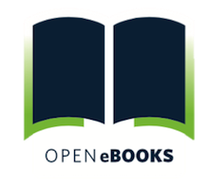
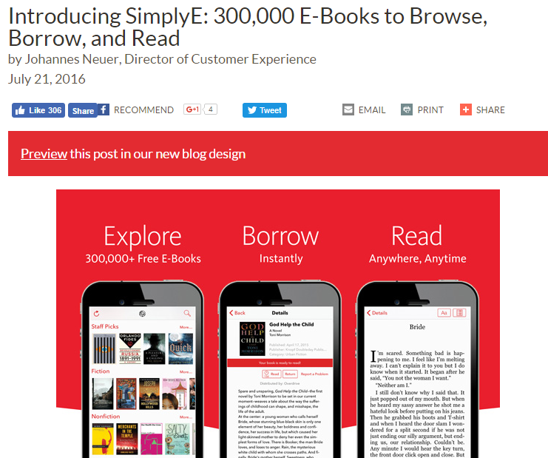
SimplyE Live
IMLS
NYPL
DPLA
First Book
Baker &
Taylor
NYPL: 30% increase in
ebook circulation since launch
“Open eBooks is soon to celebrate
1 million ebooks checked out”
Notes:
The initiative’s partners -- Digital Public Library of America (DPLA), First Book, and The New York Public Library (NYPL), with content support from digital books distributor Baker & Taylor -- created the app, curated the eBook collection, and developed a system for distribution and use. They received financial support from the Institute of Museum and Library Services (IMLS)

Slide 6
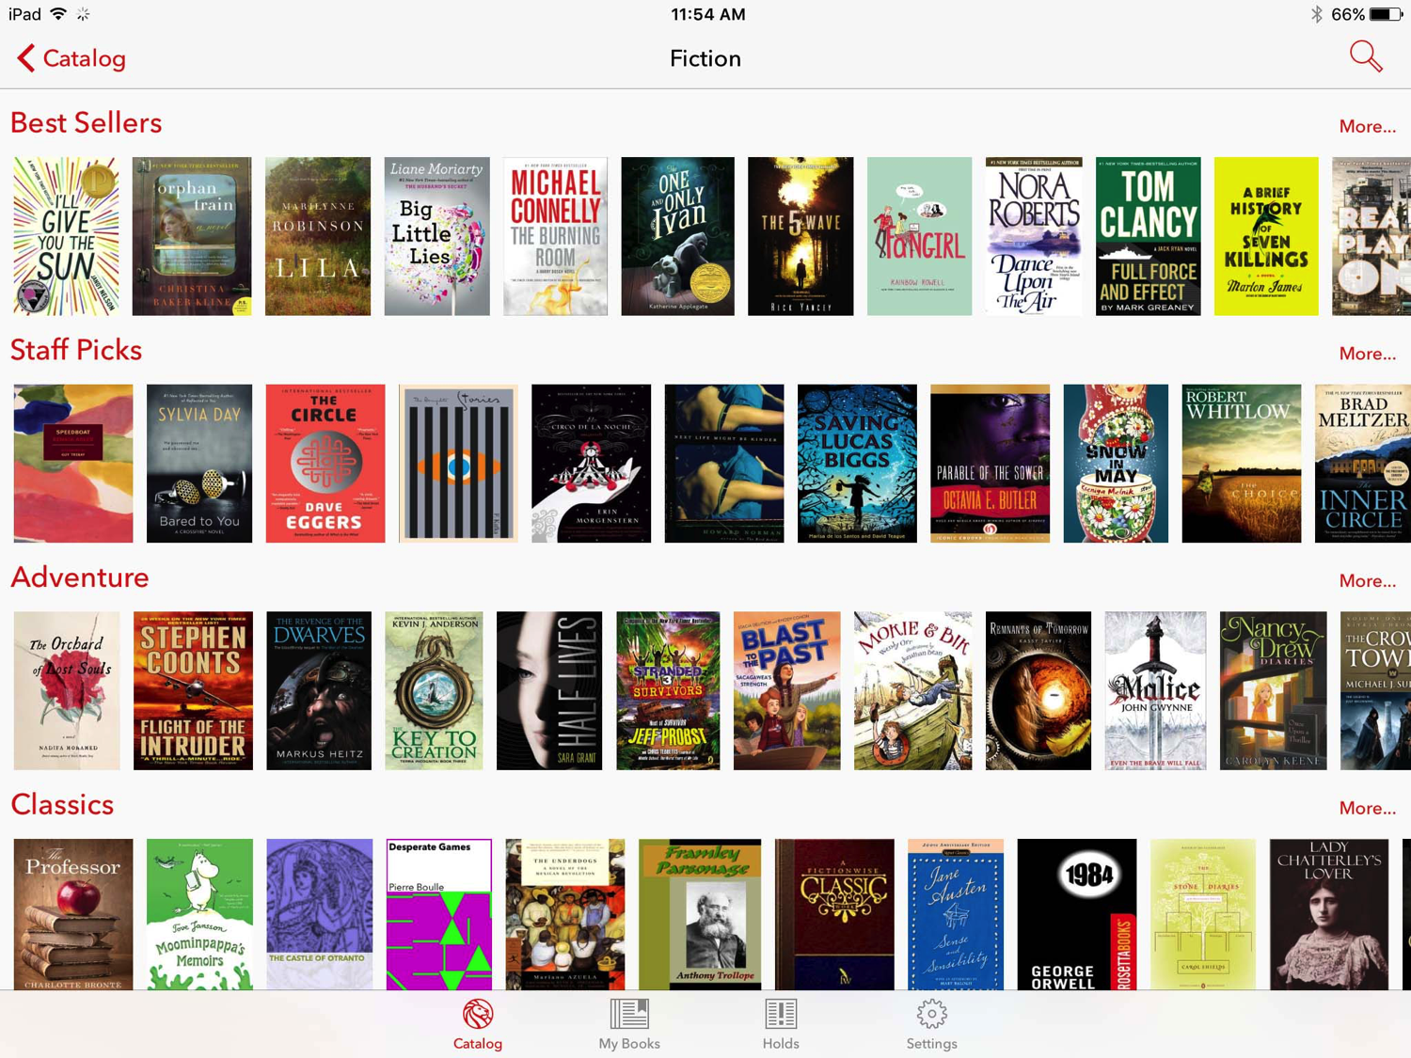

Slide 7
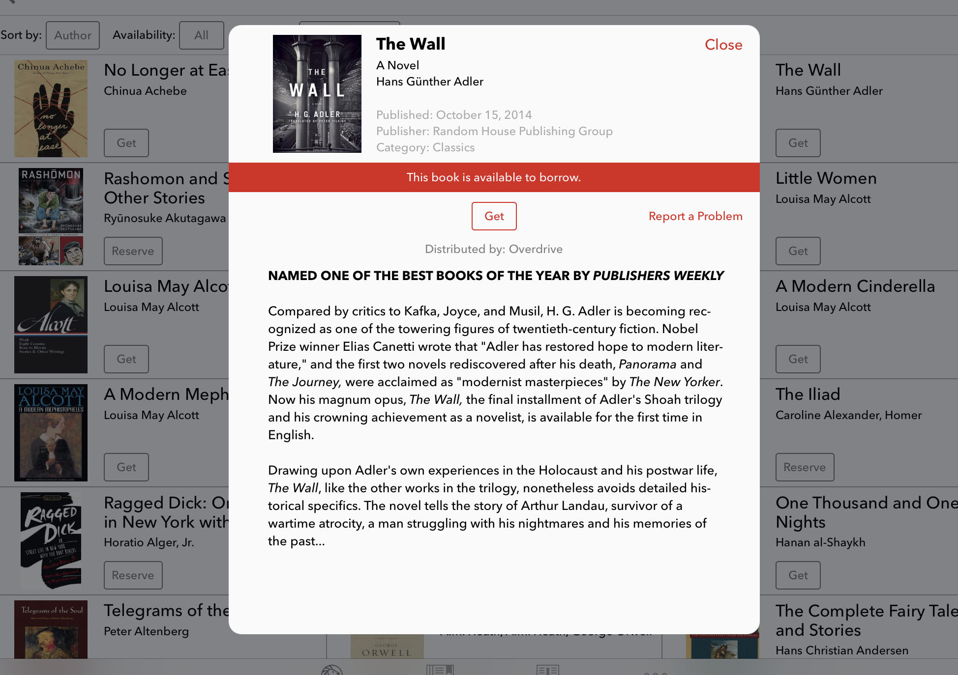

Slide 8
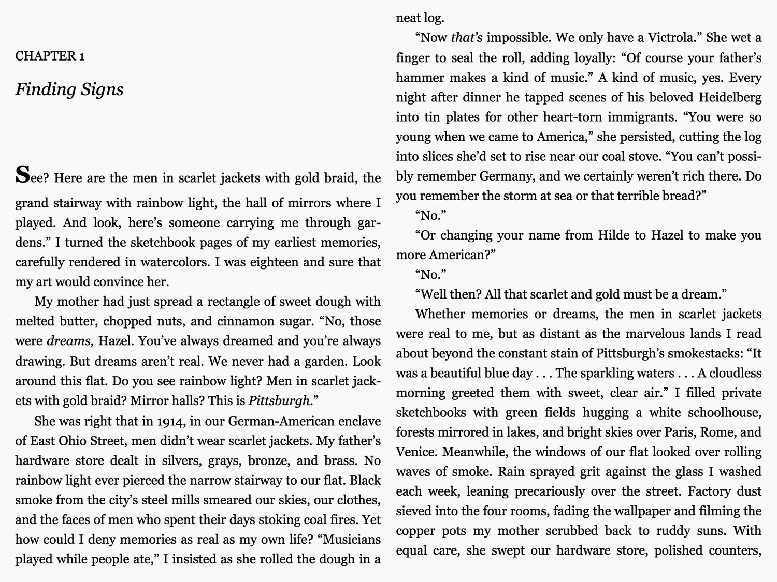

Slide 9
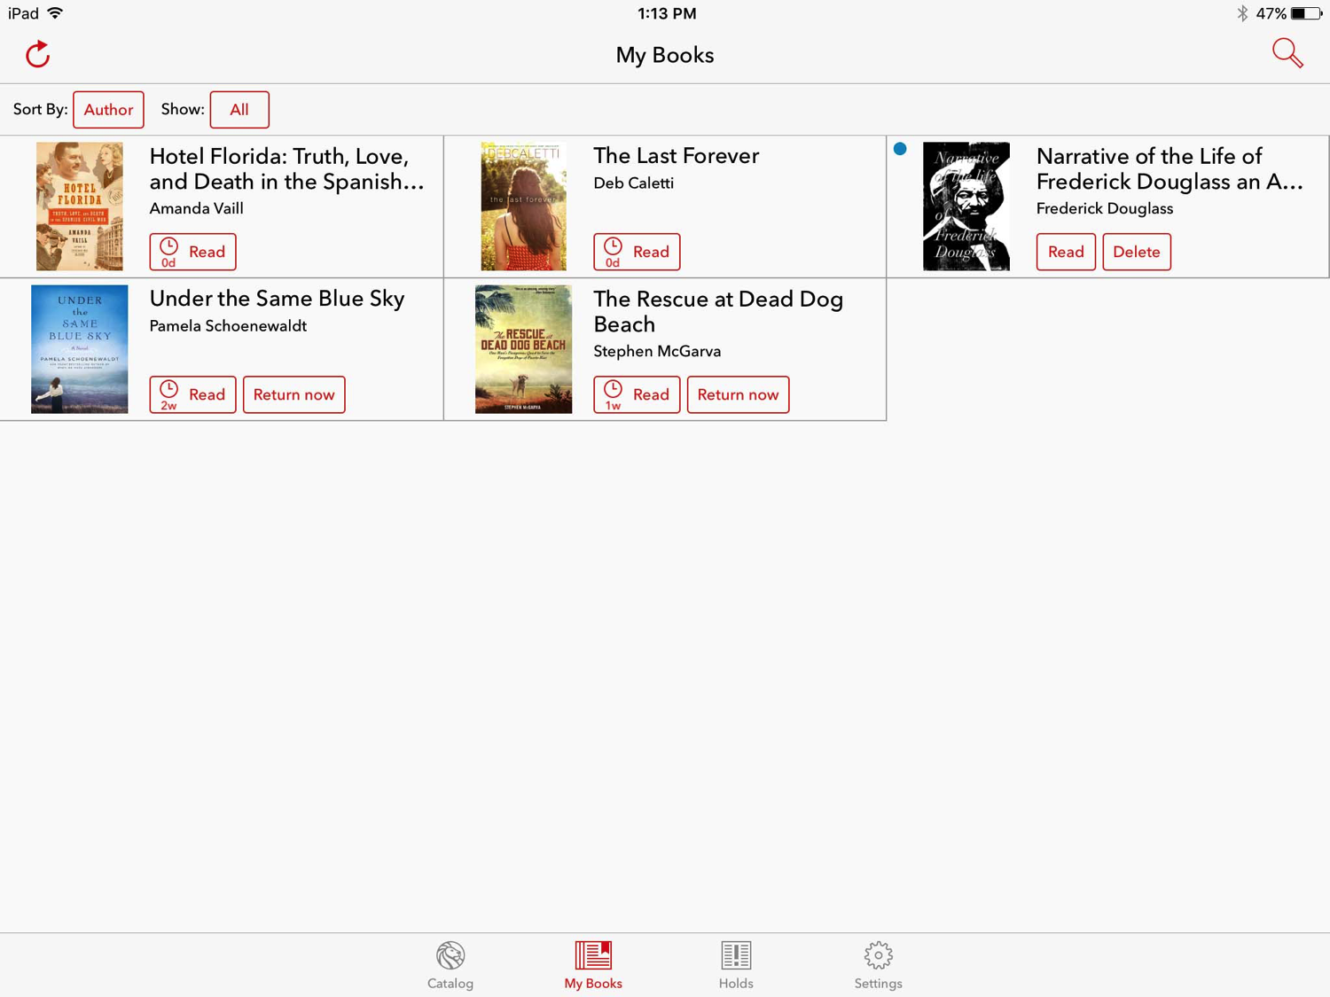

Slide 10
ROLE
3rd IMLS Grant in series - SimplyE for Consortia
Readium sub-licensing for libraries
Help build the developer community
Develop effective documentation
Test installations with two local public libraries
Public domain content
Open textbooks and scholarly monographs
Notes:
Explain what Minitex is
NYPL realized they had to find partners with organizations like Minitex
Work with DPLA on public domain

Slide 11
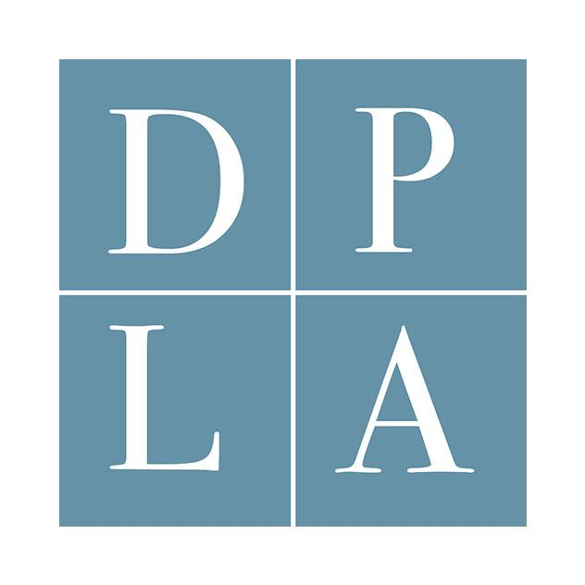
SimplyE for Consortia
Two-year grant: July 2016 - June 2018
PRIMARY PARTNERS
Other Partners
University of Minnesota
Boston Public
Connecticut State Library
Public libraries in MN and IL
CALIFA (CA)
Others
Notes:
We are also talking to many others such as the Kansas State Library, Amigos, Maryland consortia, Arizona academic libraries

Slide 12
SimplyE Model
Public Library
SimplyE
Library Patron
Notes:
OneClickDigital, BIblioBoard, and Feedbook is being developed

Slide 13
SimplyE for Consortia
Patron Centric Model
Public Library
Academic or K12 Library
content
Statewide or Consortia Content
SimplyE for Consortia
Library Patron
Notes:
We’ll calling this the collection merge

Slide 14
Low Awareness
1.66 out of 5
1.88 out of 5
1.53 out of 5
Survey of 389 respondents from Sept/Oct 2016 (69% public, 16% consortia, 9 academic)

Slide 15
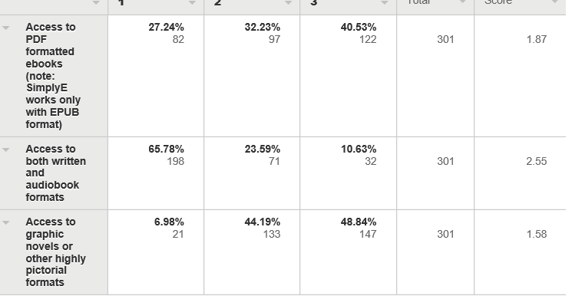
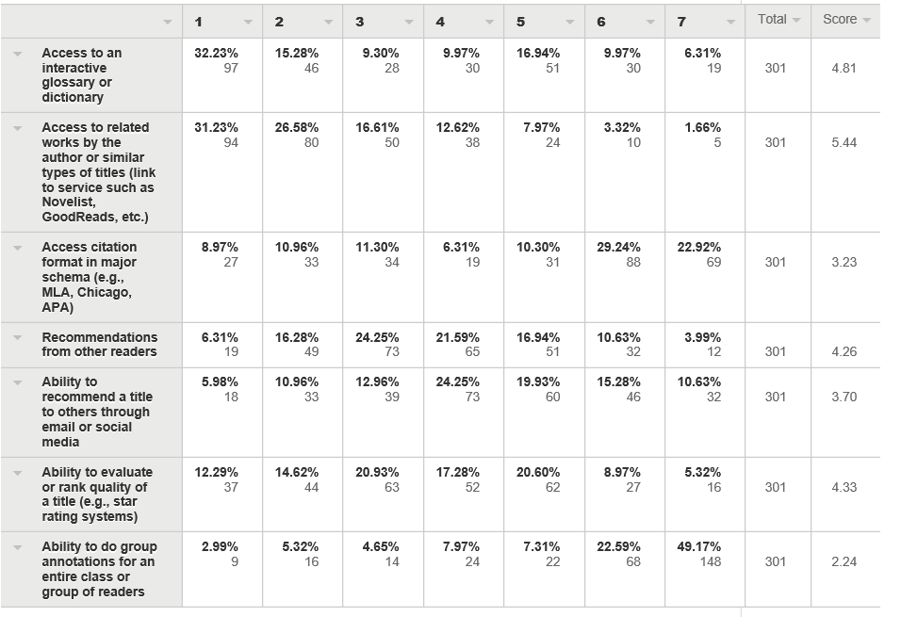
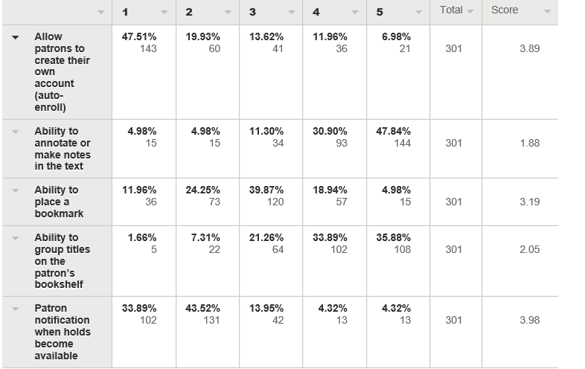
Top requests for development:
Bookmarks
Holds notification
Related authors or works
Star rankings
Auto enroll
Audio format
Annotations
Citations
PDF Format (90-95% of academic content is PDF)

Slide 16
About 29% of Respondents are Considering Launching SimplyE

Slide 17
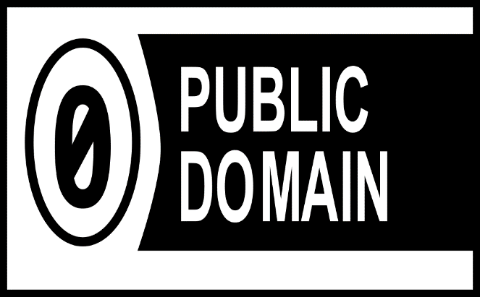
(coming soon)
Launch by the end of 2016
Top 500 Gutenberg
English titles
Spanish titles
Notes:
Possible because simplye has a local content server build into it
DPLA is also looking at a collection

Slide 18
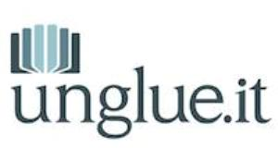
Other Possible Open Content
Scholarly Content
Popular Content
Notes:
Worldreader We are a US, Europe and Africa-based nonprofit organization transforming the lives of people in the developing world. 501(c)(3). 46,000 titles in 43 languages
Unglue it Crowdsourced: An unglued ebook is a book that's added a Creative Commons license, after payments to the author, publisher, or other rights holder.

Slide 19
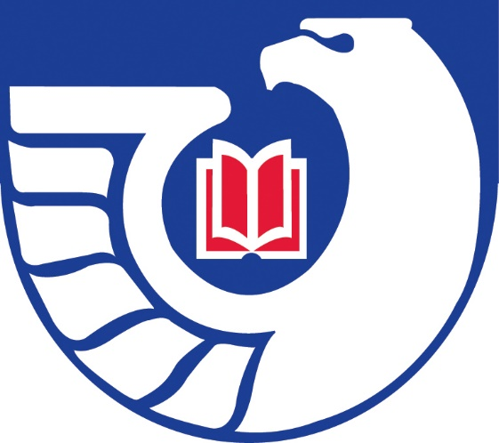
More Possible Open Content
Local or state government publications
Specific types of federal publication (i.e., EPA documents only)
Local indie presses
Local histories
Local writing contests

Slide 20
CALIFA & Kansas: Douglas County Model
Notes:
Combining locally purchased content
Local content server with Adobe Content Server
Enki (CALIFA)

Slide 21
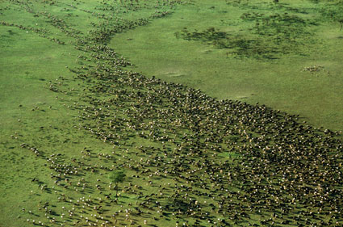
If you want to go fast, go alone; If you want to go far, go together
African Proverb
Notes:
Working with many partners in an open source environment, we can go far together even to the hype cycles plateau of productivity

